Slide 1
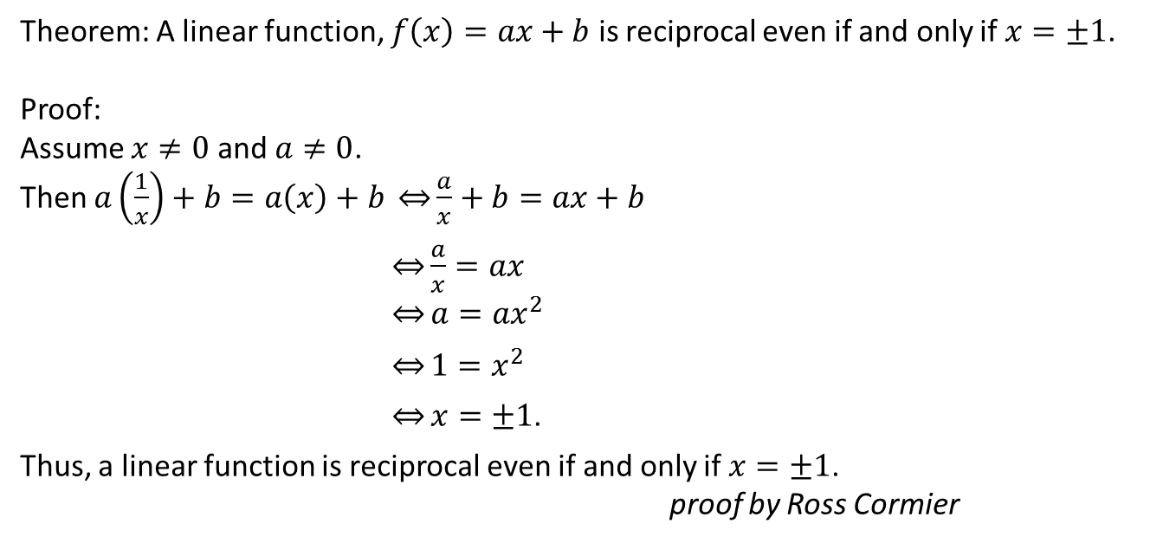
Theorem: A linear function, $f\left(x\right)=ax+b$ is reciprocal even if and only if $x=±1$.
Proof:
Assume $x≠0$ and $a≠0$.
Then $a\left(\frac{1}{x}\right)+b=a\left(x\right)+b \overset{⇔}{}\frac{a}{x}+b=ax+b$
$\underset{⇔}{}\frac{a}{x}=ax$
$\overset{⇔}{}a=ax^{2}$
$\overset{⇔}{}1=x^{2}$
$\overset{⇔}{}x=±1$.
Thus, a linear function is reciprocal even if and only if$x=±1$.
proof by Ross Cormier

Slide 2
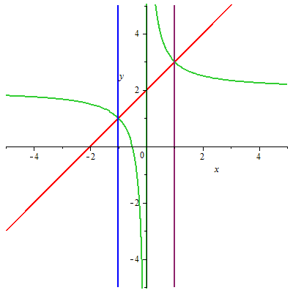
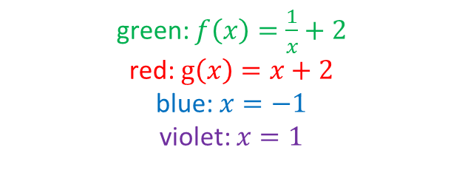
green: $f\left(x\right)=\frac{1}{x}+2$
red: $g\left(x\right)=x+2$
blue: $x=−1$
violet: $x=1$

Slide 3
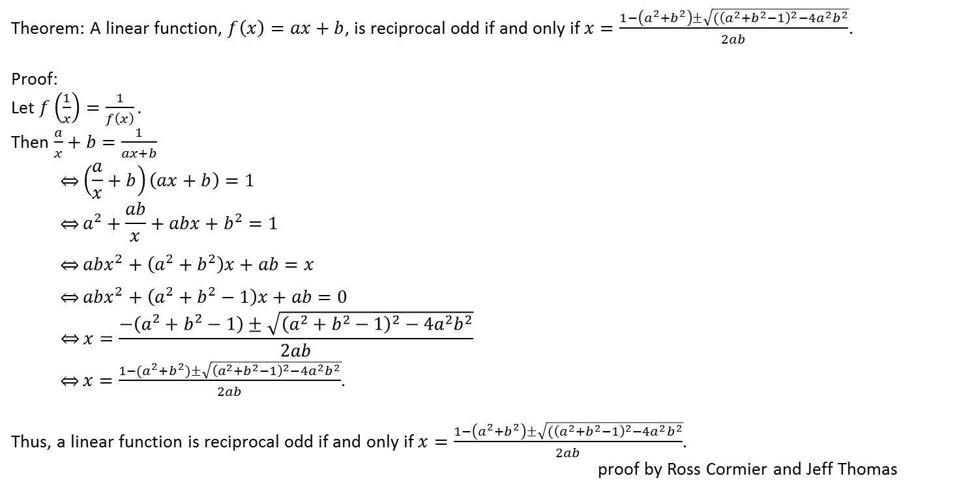
Theorem: A linear function, $f\left(x\right)=ax+b$, is reciprocal odd if and only if $x=\frac{1−\left(a^{2}+b^{2}\right)±\sqrt{{(\left(a^{2}+b^{2}−1\right)}^{2}−4a^{2}b^{2}}}{2ab}$.
Proof:
Let $f\left(\frac{1}{x}\right)=\frac{1}{f\left(x\right)}.$
Then $\frac{a}{x}+b=\frac{1}{ax+b}$
$$\underset{⇔}{}\left(\frac{a}{x}+b\right)\left(ax+b\right)=1$$
$$\underset{⇔}{}a^{2}+\frac{ab}{x}+abx+b^{2}=1$$
$$\underset{⇔}{}abx^{2}+\left(a^{2}+b^{2}\right)x+ab=x$$
$$\underset{⇔}{}abx^{2}+\left(a^{2}+b^{2}−1\right)x+ab=0$$
$$\underset{⇔}{}x=\frac{−\left(a^{2}+b^{2}−1\right)±\sqrt{{\left(a^{2}+b^{2}−1\right)}^{2}−4a^{2}b^{2}}}{2ab}$$
$\underset{⇔}{}x=\frac{1−(a^{2}+b^{2})±\sqrt{{\left(a^{2}+b^{2}−1\right)}^{2}−4a^{2}b^{2}}}{2ab}$.
Thus, a linear function is reciprocal odd if and only if $x=\frac{1−\left(a^{2}+b^{2}\right)±\sqrt{{(\left(a^{2}+b^{2}−1\right)}^{2}−4a^{2}b^{2}}}{2ab}$.
proof by Ross Cormier and Jeff Thomas

Slide 4
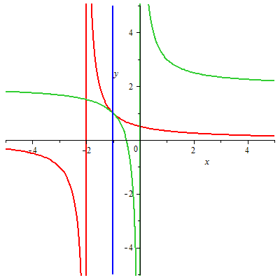

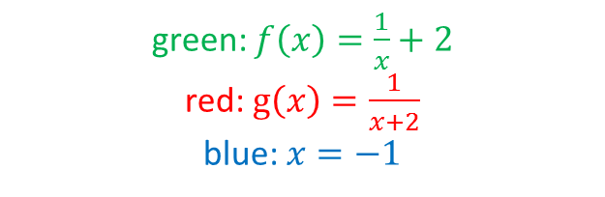
$$a=1, b=2$$
$$\frac{1−(a^{2}+b^{2})±\sqrt{{\left(a^{2}+b^{2}−1\right)}^{2}−4a^{2}b^{2}}}{2ab}=\frac{1−(1^{2}+2^{2})±\sqrt{{\left(1^{2}+2^{2}−1\right)}^{2}−4∙2^{2}}}{2∙2}$$
$=\frac{−4±\sqrt{{\left(4\right)}^{2}−4∙4}}{4}$
$=−\frac{4±\sqrt{16−16}}{4}$
$=−\frac{4±\sqrt{0}}{4}$
$=−\frac{4}{4}$
$=−1$
$$f\left(−1\right)=\frac{1}{−1}+2=−1+2=1$$
$$g\left(−1\right)=\frac{1}{−1+2}=\frac{1}{1}=1$$
green: $f\left(x\right)=\frac{1}{x}+2$
red: $g\left(x\right)=\frac{1}{x+2}$
blue: $x=−1$

Slide 5

Theorem: A quadratic function, $f\left(x\right)=ax^{2}+bx+c$, is reciprocal even if $x=\frac{−b±\sqrt{b^{2}−4a^{2}}}{2a}$.
Proof:
Let $f\left(x\right)=ax^{2}+bx+c$.
Then $f\left(\frac{1}{x}\right)=f\left(x\right)\underset{⇒}{}a{\left(\frac{1}{x}\right)}^{2}+b\left(\frac{1}{x}\right)+c=ax^{2}+bx+c$
$\underset{⇒}{}\frac{a}{x^{2}}+\frac{b}{x}=ax^{2}+bx$
$\underset{⇒}{}\frac{a}{x^{2}}−ax^{2}=bx−\frac{b}{x}$
$\underset{⇒}{}a\left(\frac{1}{x^{2}}−x^{2}\right)=b\left(x−\frac{1}{x}\right)$
$\underset{⇒}{}a\left(\frac{1}{x}−x\right)\left(\frac{1}{x}+x\right)=−b\left(\frac{1}{x}−x\right)$
$\underset{⇒}{}a\left(\frac{1}{x}+x\right)=−b$
$\underset{⇒}{}ax+\frac{a}{x}=−b$
$\underset{⇒}{}ax^{2}+bx+a=0$
$\underset{⇒}{}x=\frac{−b±\sqrt{b^{2}−4a^2}}{2a}.$
Thus, a quadratic function is reciprocal even if $x=\frac{−b±\sqrt{b^{2}−4a^{2}}}{2a}$.
proof by Emm MacArthur

Slide 6
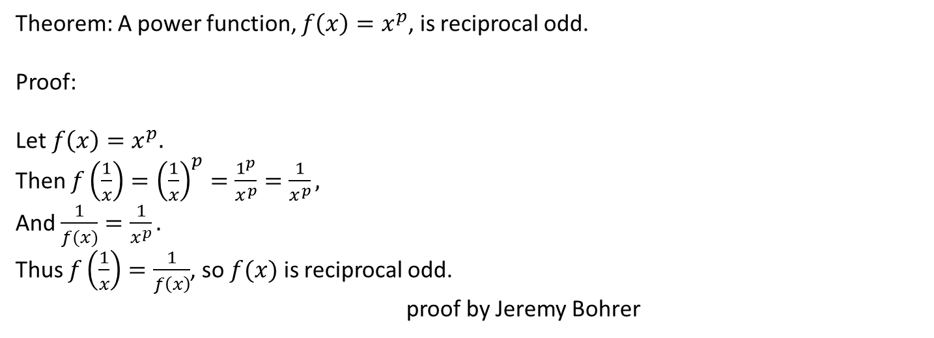
Theorem: A power function, $f\left(x\right)=x^{p}$, is reciprocal odd.
Proof:
Let $f\left(x\right)=x^{p}.$
Then $f\left(\frac{1}{x}\right)={\left(\frac{1}{x}\right)}^{p}=\frac{1^{p}}{x^{p}}=\frac{1}{x^{p}},$
And $\frac{1}{f(x)}=\frac{1}{x^{p}}.$
Thus $f\left(\frac{1}{x}\right)=\frac{1}{f\left(x\right)}$, so $f(x)$ is reciprocal odd.
proof by Jeremy Bohrer

Slide 7
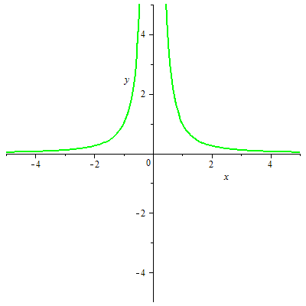
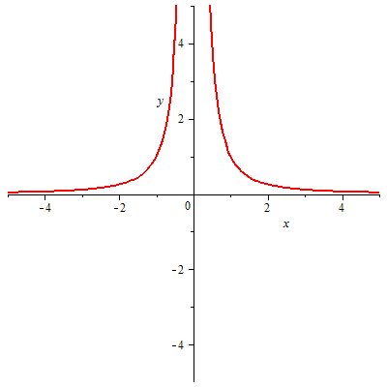
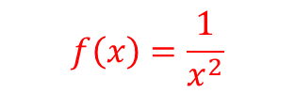

$$f\left(x\right)={\left(\frac{1}{x}\right)}^{2}$$
$$f\left(x\right)=\frac{1}{x^{2}}$$

Slide 8

Theorem: If $f\left(x\right)=ax^{2}+c$, $f(x)$ is reciprocal odd if and only if $x=±\sqrt{\frac{−a^{2}−c^{2}+1±\sqrt{{\left(a^{2}+c^{2}−1\right)}^{2}−4a^{2}c^{2}}}{2ac}}$.
Proof:
Let $f\left(x\right)=ax^{2}+c$, and assume $f\left(\frac{1}{x}\right)=\frac{1}{f\left(x\right)}$.
Then $a{\left(\frac{1}{x}\right)}^{2}+c=\frac{1}{ax^{2}+c}$
$\underset{⇔}{}\left(\frac{a}{x^{2}}+c\right)\left(ax^{2}+c\right)=1$
$\underset{⇔}{}a^{2}+\frac{ac}{x^{2}}+acx^{2}+c^{2}=1$
$\underset{⇔}{}acx^{2}+\left(a^{2}+c^{2}−1\right)+\frac{ac}{x^{2}}=0$
$\underset{⇔}{}acx^{4}+\left(a^{2}+c^{2}−1\right)x^{2}+ac=0$
$\underset{⇔}{}x^{2}=\frac{−{(a}^{2}+c^{2}−1)±\sqrt{{\left(a^{2}+c^{2}−1\right)}^{2}−4a^{2}c^{2}}}{2ac}$
$\underset{⇔}{}x=±\sqrt{\frac{−{(a}^{2}+c^{2}−1)±\sqrt{{\left(a^{2}+c^{2}−1\right)}^{2}−4a^{2}c^{2}}}{2ac}}.$
Thus, if $f\left(x\right)=ax^{2}+c$, $f(x)$ is reciprocal odd if and only if $x=±\sqrt{\frac{−a^{2}−c^{2}+1±\sqrt{{\left(a^{2}+c^{2}−1\right)}^{2}−4a^{2}c^{2}}}{2ac}}$.
proof by Nick Kallfa

Slide 9
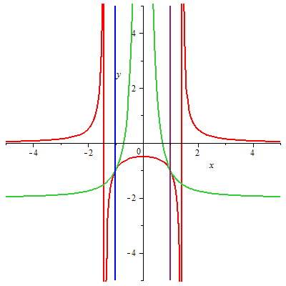
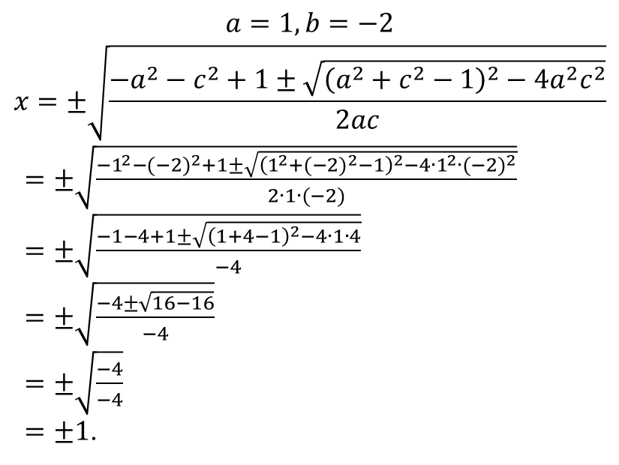
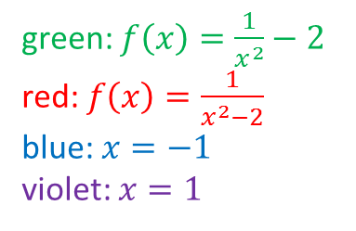
green: $f\left(x\right)=\frac{1}{x^{2}}−2$
red: $f\left(x\right)=\frac{1}{x^{2}−2}$
blue: $x=−1$
violet: $x=1$
$$a=1, b=−2$$
$$x=±\sqrt{\frac{−a^{2}−c^{2}+1±\sqrt{{\left(a^{2}+c^{2}−1\right)}^{2}−4a^{2}c^{2}}}{2ac}}$$
$=±\sqrt{\frac{−1^{2}−{(−2)}^{2}+1±\sqrt{{\left(1^{2}+{(−2)}^{2}−1\right)}^{2}−4{∙1}^{2}∙{(−2)}^{2}}}{2∙1∙(−2)}}$
$=±\sqrt{\frac{−1−4+1±\sqrt{{\left(1+4−1\right)}^{2}−4∙1∙4}}{−4}}$
$=±\sqrt{\frac{−4±\sqrt{16−16}}{−4}}$
$=±\sqrt{\frac{−4}{−4}}$
$=±1$.

Slide 10
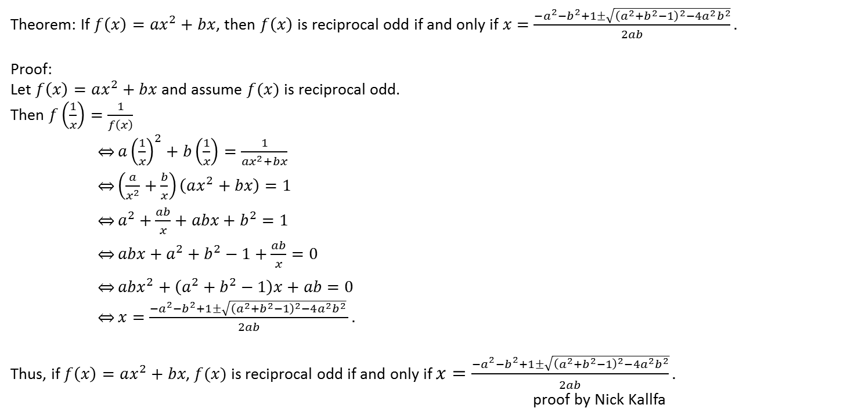
Theorem: If $f\left(x\right)={ax}^{2}+bx$, then $f\left(x\right)$ is reciprocal odd if and only if $x=\frac{−a^{2}−b^{2}+1±\sqrt{{\left(a^{2}+b^{2}−1\right)}^{2}−4a^{2}b^{2}}}{2ab}.$
Proof:
Let $f\left(x\right)=ax^{2}+bx$ and assume $f(x)$ is reciprocal odd.
Then $f\left(\frac{1}{x}\right)=\frac{1}{f\left(x\right)}$
$\underset{⇔}{}a{\left(\frac{1}{x}\right)}^{2}+b\left(\frac{1}{x}\right)=\frac{1}{ax^{2}+bx}$
$\underset{⇔}{}\left(\frac{a}{x^{2}}+\frac{b}{x}\right)\left(ax^{2}+bx\right)=1$
$\underset{⇔}{}a^{2}+\frac{ab}{x}+abx+b^{2}=1$
$\underset{⇔}{}abx+a^{2}+b^{2}−1+\frac{ab}{x}=0$
$\underset{⇔}{}abx^{2}+\left(a^{2}+b^{2}−1\right)x+ab=0$
$\underset{⇔}{}x=\frac{{−a}^{2}−b^{2}+1±\sqrt{{\left(a^{2}+b^{2}−1\right)}^{2}−4a^{2}b^{2}} }{2ab}.$
Thus, if $f\left(x\right)=ax^{2}+bx$, $f(x)$ is reciprocal odd if and only if $x=\frac{−a^{2}−b^{2}+1±\sqrt{{\left(a^{2}+b^{2}−1\right)}^{2}−4a^{2}b^{2}}}{2ab}.$
proof by Nick Kallfa

Slide 11
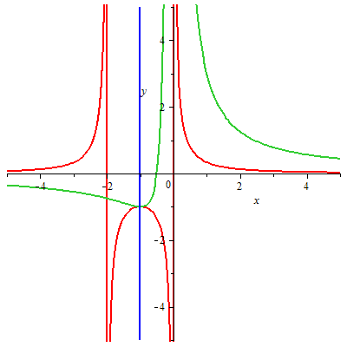
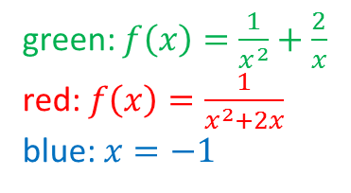
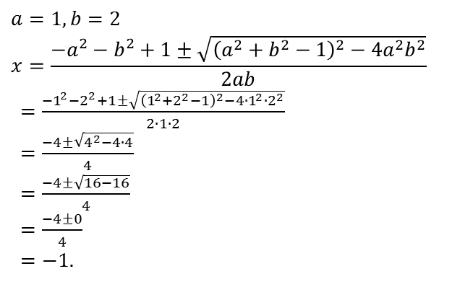
green: $f\left(x\right)=\frac{1}{x^{2}}+\frac{2}{x}$
red: $f\left(x\right)=\frac{1}{x^{2}+2x}$
blue: $x=−1$
$$a=1, b=2$$
$$x=\frac{−a^{2}−b^{2}+1±\sqrt{{\left(a^{2}+b^{2}−1\right)}^{2}−4a^{2}b^{2}}}{2ab}$$
$=\frac{−1^{2}−2^{2}+1±\sqrt{{\left(1^{2}+2^{2}−1\right)}^{2}−4∙1^{2}∙2^{2}}}{2∙1∙2}$
$=\frac{−4±\sqrt{4^{2}−4∙4}}{4}$
$=\frac{−4±\sqrt{16−16}}{4}$
$=\frac{−4±0}{4}$
$=−1.$

Slide 12
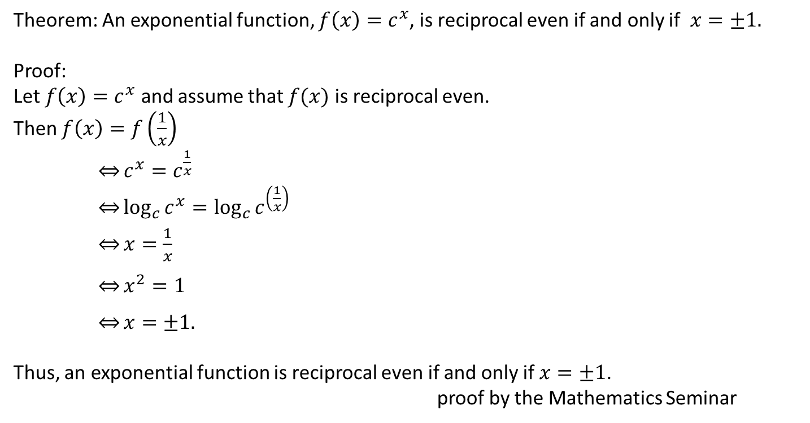
Theorem: An exponential function, $f\left(x\right)=c^{x}$, is reciprocal even if and only if $x=±1.$
Proof:
Let $f\left(x\right)=c^{x}$ and assume that $f(x)$ is reciprocal even.
Then $f\left(x\right)=f\left(\frac{1}{x}\right)$
$\underset{⇔}{}c^{x}=c^{\frac{1}{x}}$
$\underset{⇔}{}\log_{c}{c^{x}=\log_{c}{c^{\left(\frac{1}{x}\right)}}}$
$\underset{⇔}{}x=\frac{1}{x}$
$\underset{⇔}{}x^{2}=1$
$\underset{⇔}{}x=±1.$
Thus, an exponential function is reciprocal even if and only if $x=±1$.
proof by the Mathematics Seminar

Slide 13
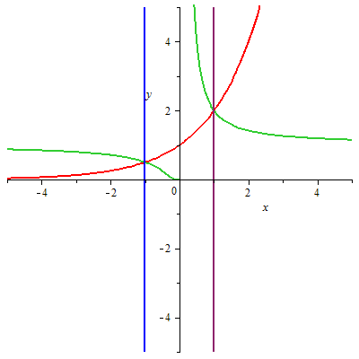
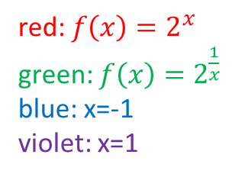
red: $f\left(x\right)=2^{x}$
green: $f\left(x\right)=2^{\frac{1}{x}}$
blue: x=-1
violet: x=1

Slide 14
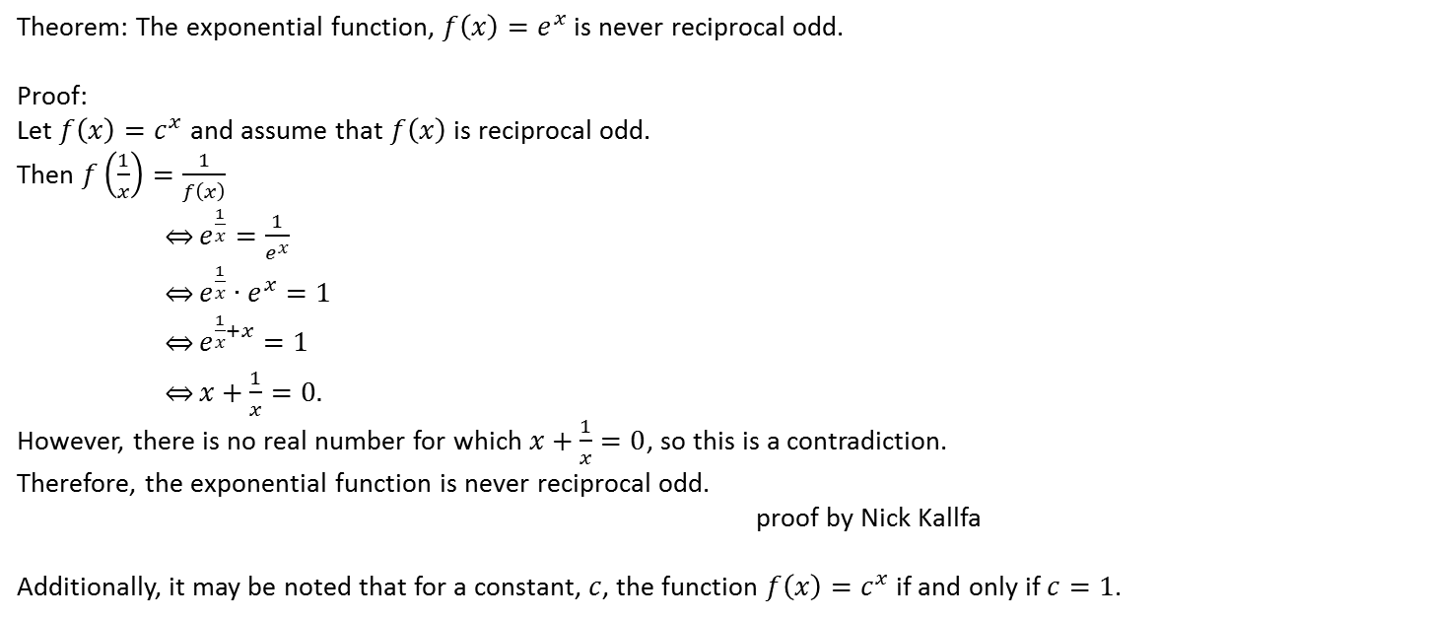
Theorem: The exponential function, $f\left(x\right)=e^{x}$ is never reciprocal odd.
Proof:
Let $f\left(x\right)=c^{x}$ and assume that $f\left(x\right)$ is reciprocal odd.
Then $f\left(\frac{1}{x}\right)=\frac{1}{f\left(x\right)}$
$\underset{⇔}{}e^{\frac{1}{x}}=\frac{1}{e^{x}}$
$\underset{⇔}{}e^{\frac{1}{x}}∙e^{x}=1$
$\underset{⇔}{}e^{\frac{1}{x}+x}=1$
$\underset{⇔}{}x+\frac{1}{x}=0.$
However, there is no real number for which $x+\frac{1}{x}=0$, so this is a contradiction.
Therefore, the exponential function is never reciprocal odd.
proof by Nick Kallfa
Additionally, it may be noted that for a constant, $c$, the function ${f\left(x\right)=c}^{x}$ if and only if $c=1$.

Slide 15
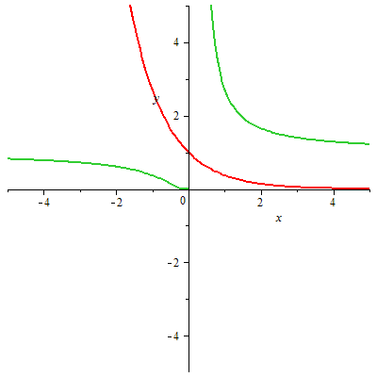
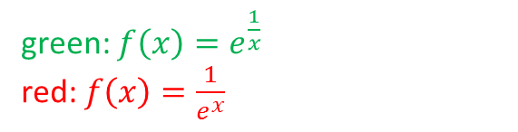
green: $f\left(x\right)=e^{\frac{1}{x}}$
red: $f\left(x\right)=\frac{1}{e^{x}}$

Slide 16
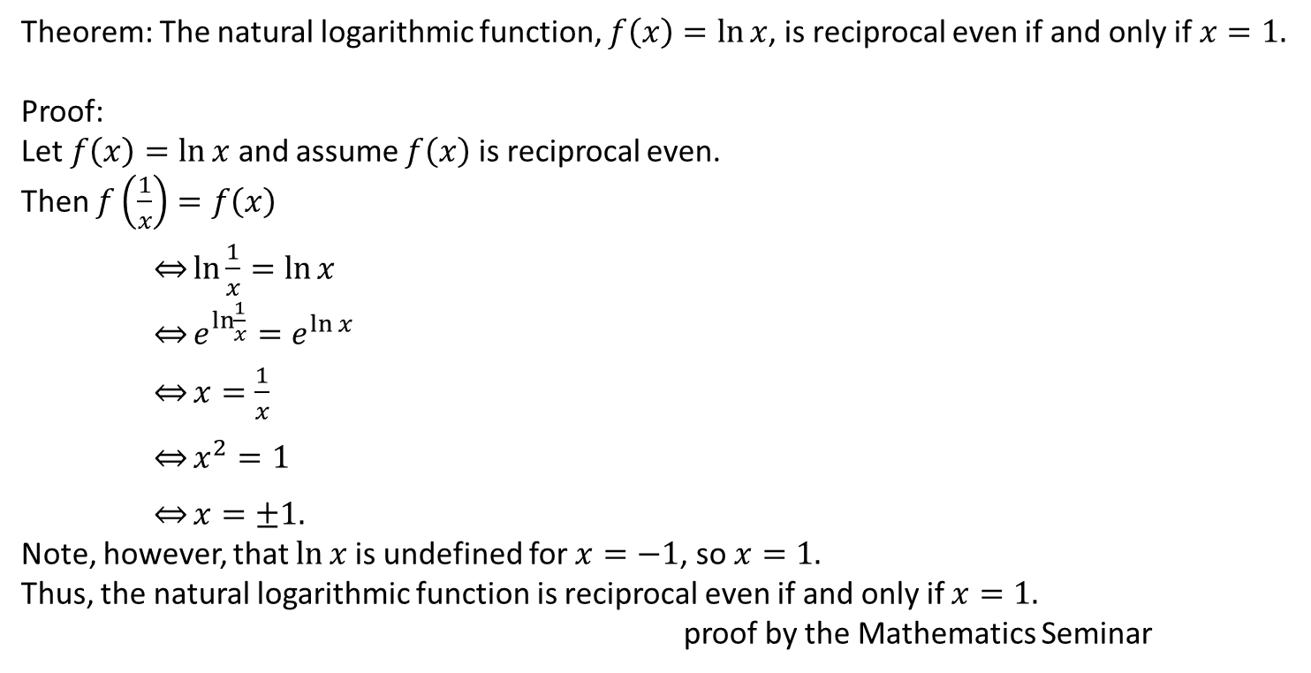
Theorem: The natural logarithmic function, $f\left(x\right)=\ln{x}$, is reciprocal even if and only if $x=1.$
Proof:
Let $f\left(x\right)=\ln{x}$ and assume $f\left(x\right)$ is reciprocal even.
Then $f\left(\frac{1}{x}\right)=f\left(x\right)$
$\underset{⇔}{}\ln{\frac{1}{x}}=\ln{x}$
$\underset{⇔}{}e^{\ln{\frac{1}{x}}}=e^{\ln{x}}$
$\underset{⇔}{}x=\frac{1}{x}$
$\underset{⇔}{}x^{2}=1$
$\underset{⇔}{}x=±1.$
Note, however, that $\ln{x}$ is undefined for $x=−1$, so $x=1.$
Thus, the natural logarithmic function is reciprocal even if and only if $x=1.$
proof by the Mathematics Seminar

Slide 17
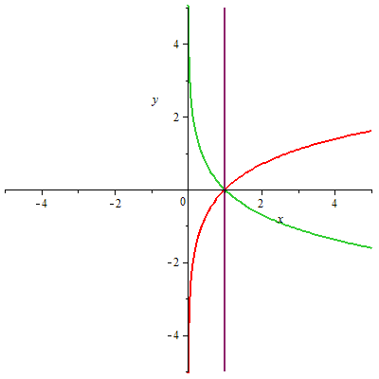
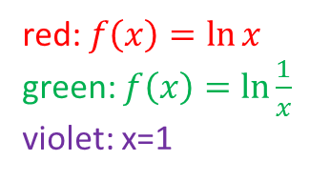
red: $f\left(x\right)=\ln{x}$
green: $f\left(x\right)=\ln{\frac{1}{x}}$
violet: x=1

Slide 18
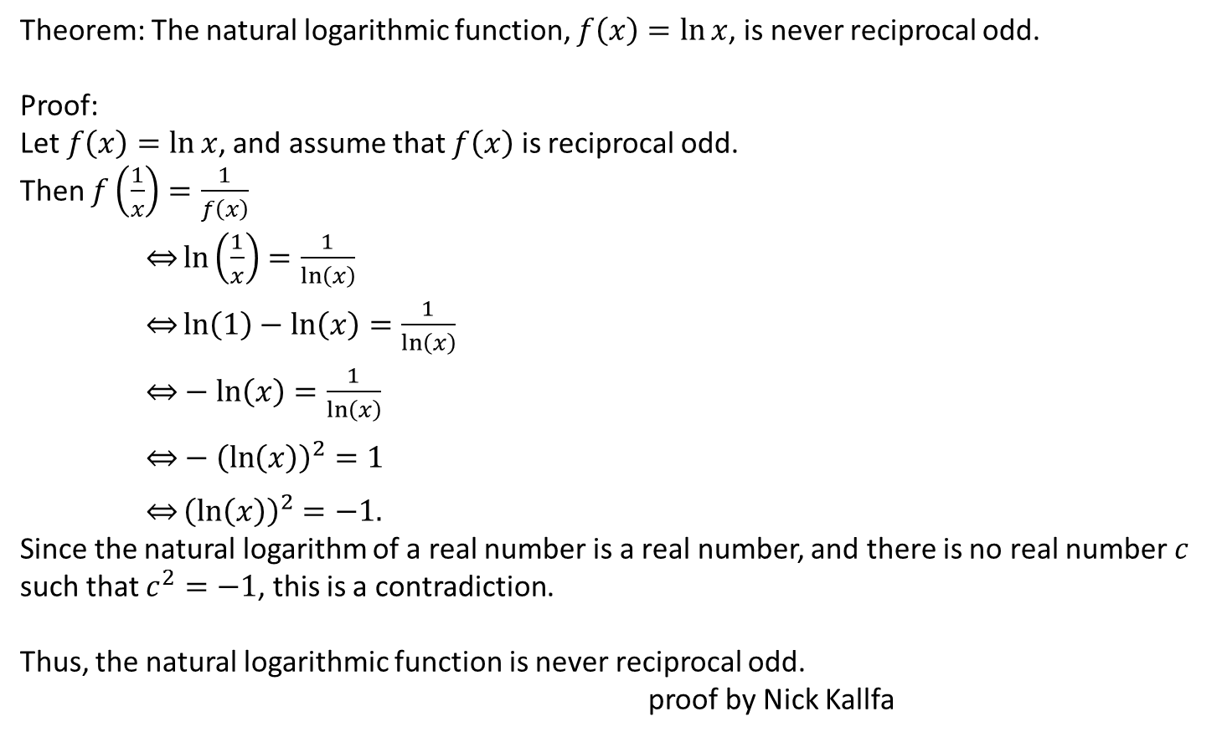
Theorem: The natural logarithmic function, $f\left(x\right)=\ln{x}$, is never reciprocal odd.
Proof:
Let $f\left(x\right)=\ln{x}$, and assume that $f\left(x\right)$ is reciprocal odd.
Then $f\left(\frac{1}{x}\right)=\frac{1}{f\left(x\right)}$
$\underset{⇔}{}\ln\left(\frac{1}{x}\right)=\frac{1}{\ln\left(x\right)}$
$\underset{⇔}{}\ln\left(1\right)−\ln\left(x\right)=\frac{1}{\ln\left(x\right)}$
$\underset{⇔}{}−\ln\left(x\right)=\frac{1}{\ln\left(x\right)}$
$\underset{⇔}{}−{\left(\ln\left(x\right)\right)}^{2}=1$
$\underset{⇔}{}{\left(\ln\left(x\right)\right)}^{2}=−1.$
Since the natural logarithm of a real number is a real number, and there is no real number $c$ such that $c^{2}=−1$, this is a contradiction.
Thus, the natural logarithmic function is never reciprocal odd.
proof by Nick Kallfa

Slide 19
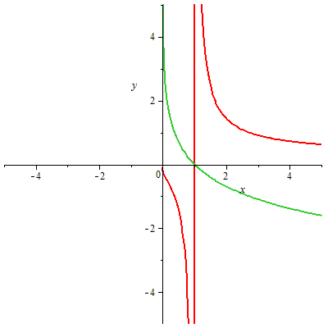
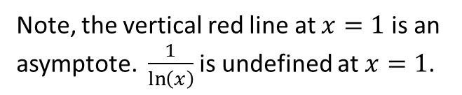
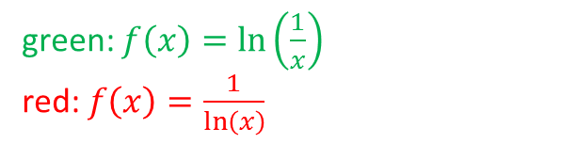
green: $f\left(x\right)=\ln\left(\frac{1}{x}\right)$
red: $f\left(x\right)=\frac{1}{\ln\left(x\right)}$
Note, the vertical red line at $x=1$ is an asymptote. $\frac{1}{\ln\left(x\right)}$ is undefined at $x=1$.

Slide 20
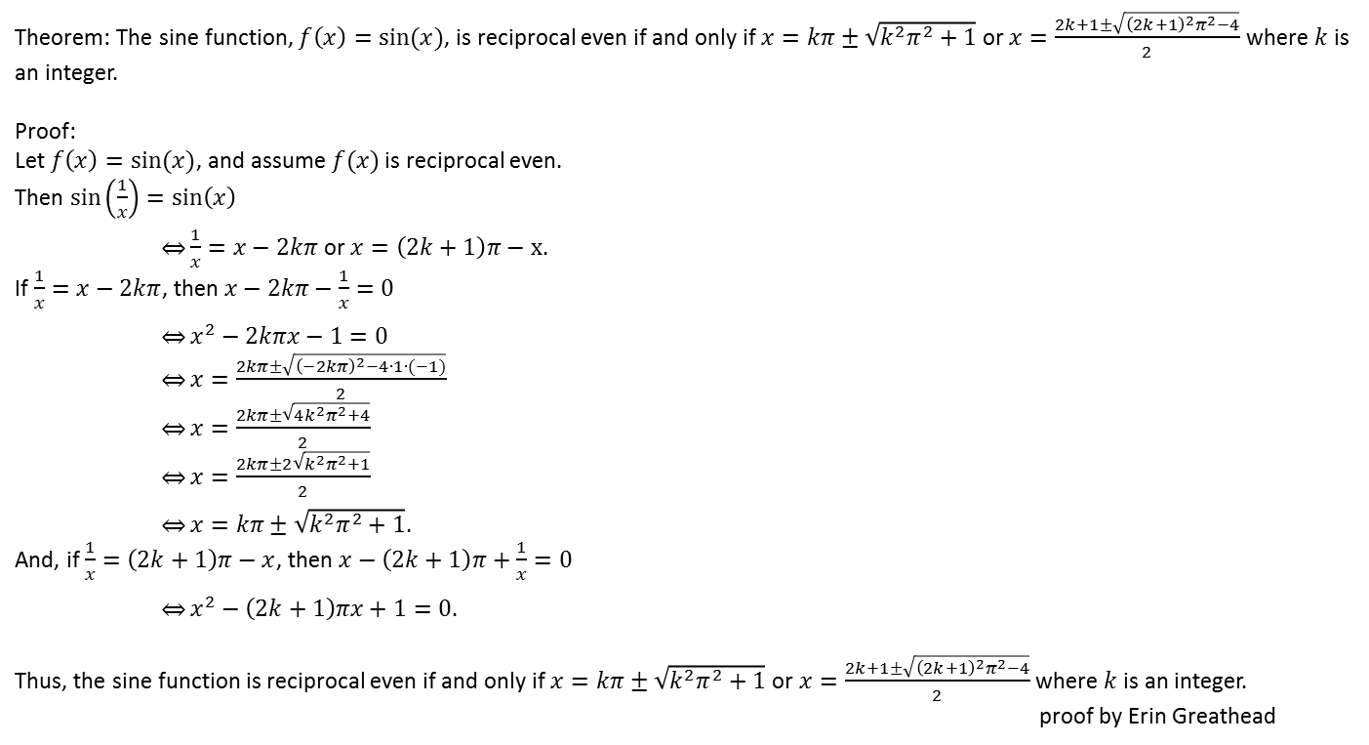
Theorem: The sine function, $f\left(x\right)=sin⁡(x)$, is reciprocal even if and only if $x=kπ±\sqrt{k^{2}π^{2}+1}$ or $x=\frac{2k+1±\sqrt{{\left(2k+1\right)}^{2}π^{2}−4}}{2}$ where $k$is an integer.
Proof:
Let $f\left(x\right)=sin⁡(x)$, and assume $f(x)$ is reciprocal even.
Then $\sin\left(\frac{1}{x}\right)=\sin\left(x\right)$
$\underset{⇔}{}\frac{1}{x}=x−2kπ$ or $x=\left(2k+1\right)π−x$.
If $\frac{1}{x}=x−2kπ$, then $x−2kπ−\frac{1}{x}=0$
$\underset{⇔}{}x^{2}−2kπx−1=0$
$\underset{⇔}{}x=\frac{2kπ±\sqrt{{\left(−2kπ\right)}^{2}−4∙1∙(−1)}}{2}$
$\underset{⇔}{}x=\frac{2kπ±\sqrt{4k^{2}π^{2}+4}}{2}$
$\underset{⇔}{}x=\frac{2kπ±2\sqrt{k^{2}π^{2}+1}}{2}$
$\underset{⇔}{}x=kπ±\sqrt{k^{2}π^{2}+1}$.
And, if $\frac{1}{x}=\left(2k+1\right)π−x$, then $x−\left(2k+1\right)π+\frac{1}{x}=0$
$\underset{⇔}{}x^{2}−\left(2k+1\right)πx+1=0$.
Thus, the sine function is reciprocal even if and only if $x=kπ±\sqrt{k^{2}π^{2}+1}$ or $x=\frac{2k+1±\sqrt{{\left(2k+1\right)}^{2}π^{2}−4}}{2}$ where $k$is an integer.
proof by Erin Greathead

Slide 21
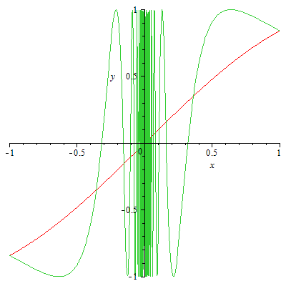
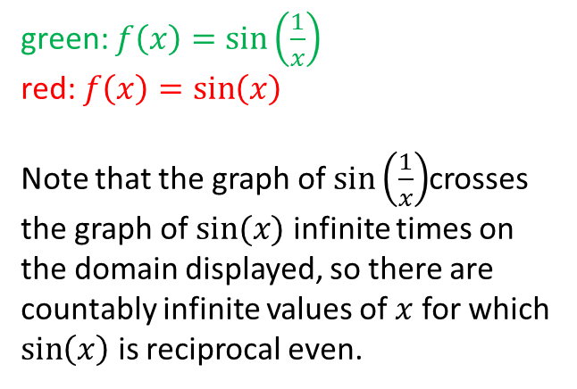
green: $f\left(x\right)=\sin\left(\frac{1}{x}\right)$
red: $f\left(x\right)=\sin\left(x\right)$
Note that the graph of $\sin\left(\frac{1}{x}\right)$crosses the graph of $sin⁡(x)$ infinite times on the domain displayed, so there are countably infinite values of $x$ for which $\sin\left(x\right)$ is reciprocal even.

Slide 22

Theorem: The sine function, $f\left(x\right)=sin⁡(x)$, is never reciprocal odd.
Proof:
Let $f\left(x\right)=\sin{x}$, and assume that $f\left(x\right)$ is reciprocal odd.
Then $f\left(\frac{1}{x}\right)=\frac{1}{f\left(x\right)}$
$\underset{⇔}{}\sin\left(\frac{1}{x}\right)=\frac{1}{\sin\left(x\right)}$
$\underset{⇔}{}\sin\left(\frac{1}{x}\right)∙\sin\left(x\right)=1$
$\underset{⇔}{}\frac{1}{2}\left(\cos\left(\frac{1}{x}−x\right)−\cos\left(\frac{1}{x}+x\right)\right)=1$
$\underset{⇔}{}\cos\left(\frac{1}{x}−x\right)−\cos\left(\frac{1}{x}+x\right)=2$ (note that $−1≤\cos\left(x\right)≤1)$
$\underset{⇔}{}\cos\left(\frac{1}{x}−x\right)=1$ and $\cos\left(\frac{1}{x}+x\right)=−1$.
If $\cos\left(\frac{1}{x}−x\right)=1$, then $\frac{1}{x}−x=2mπ$, where $m$ is an integer.
If $\cos\left(\frac{1}{x}+x\right)=−1$, then $\frac{1}{x}+x=(2n+1)π$, where $n$ is an integer.
So $\frac{1}{x}−x+\frac{1}{x}+x=2mπ+\left(2n+1\right)π$
$\underset{⇔}{}\frac{2}{x}=\left(2\left(m+n\right)+1\right)π$
$\underset{⇔}{}\frac{1}{x}=\frac{\left(2\left(m+n\right)+1\right)π}{2}$
$\underset{⇔}{}x=\frac{2}{(2\left(m+n\right)+1)π}$
And $\frac{1}{x}+x−\left(\frac{1}{x}−x\right)=\left(2n+1\right)π−2mπ$
$\underset{⇔}{}2x=(2\left(n−m\right)+1)π$
$\underset{⇔}{}x=\frac{\left(2\left(n−m\right)+1\right)π}{2}$.
Then $\frac{2}{\left(2\left(m+n\right)+1\right)π}=\frac{\left(2\left(n−m\right)+1\right)π}{2}$
$\underset{⇔}{}4=\left(2\left(m+n\right)+1\right)\left(2\left(n−m\right)+1\right)π^{2}$
$\underset{⇔}{}\frac{4}{π^{2}}=(2\left(m+n\right)+1)(2\left(n−m\right)+1)$.
However, $m$ and $n$ are both integers, and the integers are closed under addition and multiplication, so $(2\left(m+n\right)+1)(2\left(n−m\right)+1)$ is an integer, but $\frac{4}{π^{2}}$ is not an integer. Thus there is a contradiction.
Therefore, the sine function is never reciprocal odd.
proof by Jeremy Bohrer

Slide 23
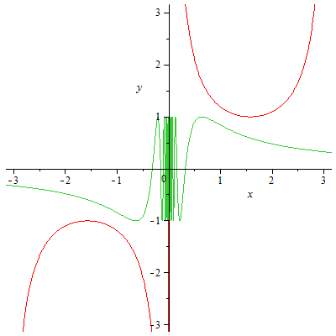
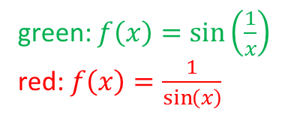
green: $f\left(x\right)=\sin\left(\frac{1}{x}\right)$
red: $f\left(x\right)=\frac{1}{\sin\left(x\right)}$

Slide 24
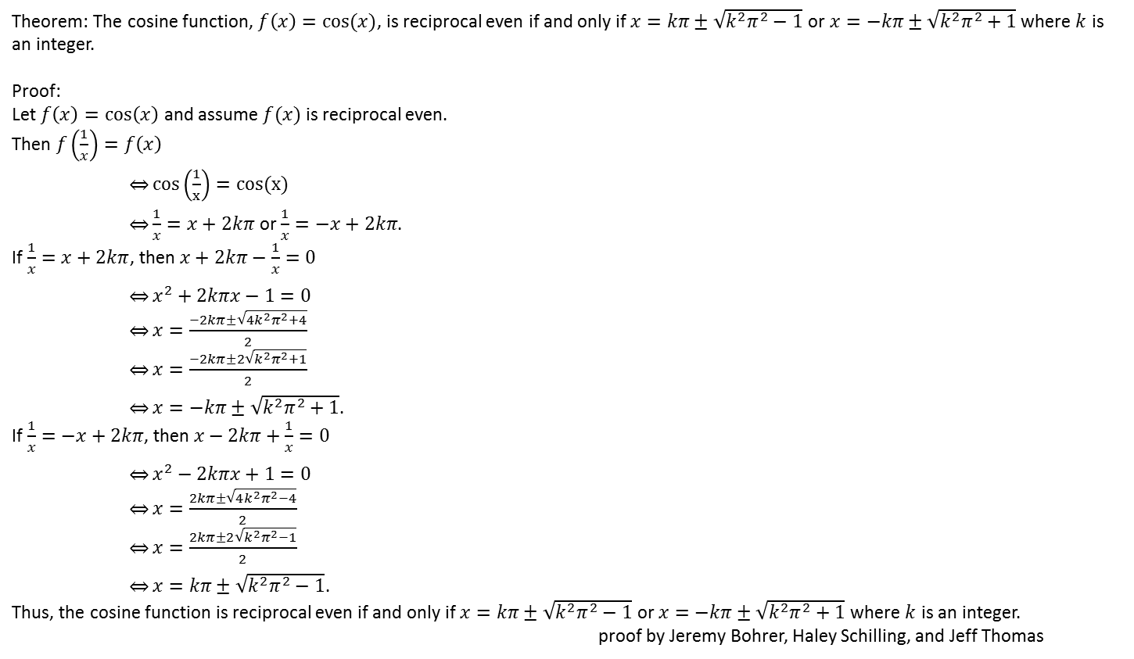
Theorem: The cosine function, $f\left(x\right)=cos⁡(x)$, is reciprocal even if and only if $x=kπ±\sqrt{k^{2}π^{2}−1}$ or $x=−kπ±\sqrt{k^{2}π^{2}+1}$ where $k$ is an integer.
Proof:
Let $f\left(x\right)=\cos\left(x\right)$ and assume $f(x)$ is reciprocal even.
Then $f\left(\frac{1}{x}\right)=f\left(x\right)$
$\underset{⇔}{}cos\left(\frac{1}{x}\right)=cos(x)$
$\underset{⇔}{}\frac{1}{x}=x+2kπ$ or $\frac{1}{x}=−x+2kπ$.
If $\frac{1}{x}=x+2kπ$, then $x+2kπ−\frac{1}{x}=0$
$\underset{⇔}{}x^{2}+2kπx−1=0$
$\underset{⇔}{}x=\frac{−2kπ±\sqrt{4k^{2}π^{2}+4}}{2}$
$\underset{⇔}{}x=\frac{−2kπ±2\sqrt{k^{2}π^{2}+1}}{2}$
$\underset{⇔}{}x=−kπ±\sqrt{k^{2}π^{2}+1}$.
If $\frac{1}{x}=−x+2kπ$, then $x−2kπ+\frac{1}{x}=0$
$\underset{⇔}{}x^{2}−2kπx+1=0$
$\underset{⇔}{}x=\frac{2kπ±\sqrt{4k^{2}π^{2}−4}}{2}$
$\underset{⇔}{}x=\frac{2kπ±2\sqrt{k^{2}π^{2}−1}}{2}$
$\underset{⇔}{}x=kπ±\sqrt{k^{2}π^{2}−1}$.
Thus, the cosine function is reciprocal even if and only if $x=kπ±\sqrt{k^{2}π^{2}−1}$ or $x=−kπ±\sqrt{k^{2}π^{2}+1}$ where $k$ is an integer.
proof by Jeremy Bohrer, Haley Schilling, and Jeff Thomas

Slide 25
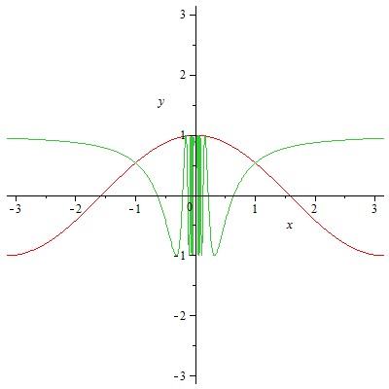
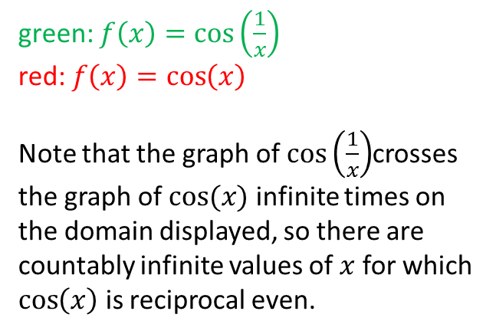
green: $f\left(x\right)=\cos\left(\frac{1}{x}\right)$
red: $f\left(x\right)=\cos\left(x\right)$
Note that the graph of $\cos\left(\frac{1}{x}\right)$crosses the graph of $cos⁡(x)$ infinite times on the domain displayed, so there are countably infinite values of $x$ for which $\cos\left(x\right)$ is reciprocal even.

Slide 26

Theorem: The cosine function, $f\left(x\right)=cos⁡(x)$, is never reciprocal odd.
Proof:
Let $f\left(x\right)=cos⁡(x)$ and assume that $f\left(x\right)$ is reciprocal odd.
Then $f\left(\frac{1}{x}\right)=\frac{1}{f\left(x\right)}$
$\underset{⇔}{}\cos\left(\frac{1}{x}\right)=\frac{1}{\cos\left(x\right)}$
$\underset{⇔}{}\cos\left(\frac{1}{x}\right)\cos\left(x\right)=1$
$\underset{⇔}{}\frac{1}{2}\left(\cos\left(x−\frac{1}{x}\right)+\cos\left(x+\frac{1}{x}\right)\right)=1$
$\underset{⇔}{}\cos\left(x−\frac{1}{x}\right)+\cos\left(x+\frac{1}{x}\right)=2$ $\text{(}\text{note} \text{that} −1≤\cos\left(x\right)≤1)$
$\underset{⇔}{}\cos\left(x−\frac{1}{x}\right)=1$ and $\cos\left(x+\frac{1}{x}\right)=1$.
If $\cos\left(x−\frac{1}{x}\right)=1$, then $x−\frac{1}{x}=2mπ$, where $m$ is an integer.
If $\cos\left(x+\frac{1}{x}\right)=1$, then $x+\frac{1}{x}=2nπ$, where $n$ is an integer.
So, $x−\frac{1}{x}+x+\frac{1}{x}=2mπ+2nπ$
$\underset{⇔}{}2x=2(m+n)π$
$\underset{⇔}{}x=\left(m+n\right)π$
$\underset{⇔}{}\frac{1}{x}=\frac{1}{\left(m+n\right)π}$.
And, $x+\frac{1}{x}−\left(x−\frac{1}{x}\right)=2nπ−2mπ$
$\underset{⇔}{}\frac{2}{x}=2(n−m)π$
$\underset{⇔}{}\frac{1}{x}=(n−m)π$.
Then, $\frac{1}{(m+n)π}=(n−m)π$
$\underset{⇔}{}\frac{1}{π^{2}}=\left(m+n\right)\left(n−m\right)$.
However, $n$ and $m$ are integers, so $(m+n)(n−m)$ is a member of the integers, but $\frac{1}{π^{2}}$ is not an integer, so there is a contradiction.
Thus, the cosine function is never reciprocal odd.
proof by Jeremy Bohrer, Haley Schilling, and Jeff Thomas

Slide 27
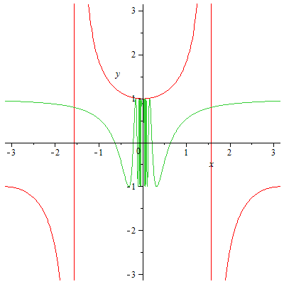
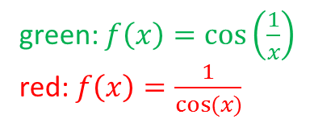
green: $f\left(x\right)=\cos\left(\frac{1}{x}\right)$
red: $f\left(x\right)=\frac{1}{cos⁡(x)}$

Slide 28
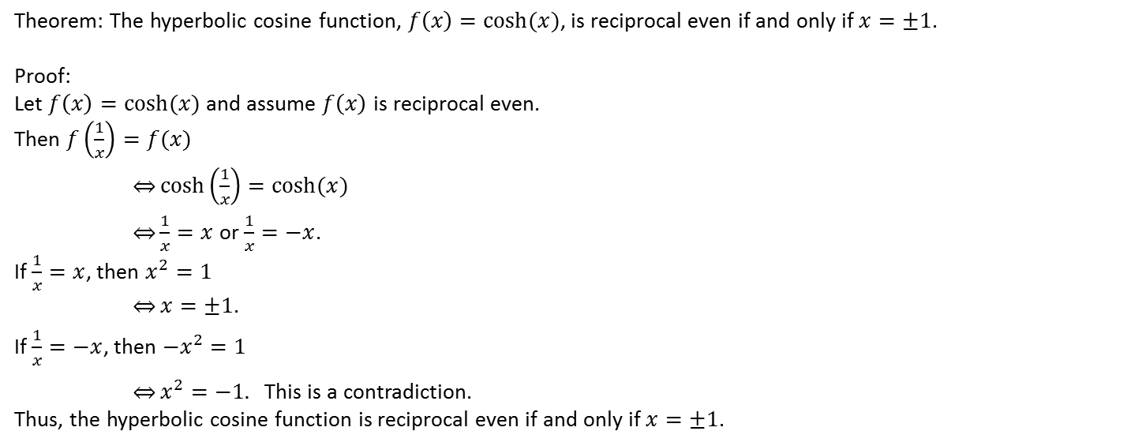
Theorem: The hyperbolic cosine function, $f\left(x\right)=cosh⁡(x)$, is reciprocal even if and only if $x=±1$.
Proof:
Let $f\left(x\right)=cosh⁡(x)$ and assume $f\left(x\right)$ is reciprocal even.
Then $f\left(\frac{1}{x}\right)=f(x)$
$\underset{⇔}{}\cosh\left(\frac{1}{x}\right)=cosh⁡(x)$
$\underset{⇔}{}\frac{1}{x}=x$ or $\frac{1}{x}=−x$.
If $\frac{1}{x}=x$, then $x^{2}=1$
$\overset{⇔}{}x=±1$.
If $\frac{1}{x}=−x$, then $−x^{2}=1$
$\underset{⇔}{}x^{2}=−1.$ This is a contradiction.
Thus, the hyperbolic cosine function is reciprocal even if and only if $x=±1$.

Slide 29
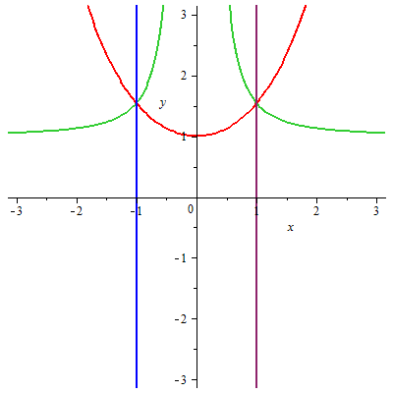
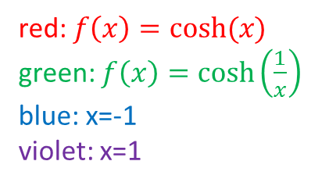
red: $f\left(x\right)=cosh⁡(x)$
green: $f\left(x\right)=\cosh\left(\frac{1}{x}\right)$
blue: x=-1
violet: x=1

Slide 30

Theorem: The hyperbolic cosine function, $f\left(x\right)=cosh⁡(x)$, is never reciprocal odd.
Proof:
Let $x$ be a non-zero real number. Suppose, for the sake of contradiction, that $\cosh\left(\frac{1}{x}\right)=\frac{1}{\cosh\left(x\right)}.$
Note that $cosh⁡(x)≥1$, and $\frac{1}{\cosh\left(x\right)}≤1$.
So $\cosh\left(\frac{1}{x}\right)=\frac{1}{\cosh\left(x\right)}=1$
$\underset{⇒}{}\cosh\left(x\right)=1$
$\underset{⇒}{}\frac{e^{x}+e^{−x}}{2}=1$
$\underset{⇒}{}e^{x}+e^{−x}=2$
$\underset{⇒}{}{\left(e^{x}\right)}^{2}+1=2e^{x}$
$\underset{⇒}{}{\left(e^{x}\right)}^{2}−2e^{x}+1=0$
$\underset{⇒}{}{\left(e^{x}−1\right)}^{2}=0$
$\underset{⇒}{}e^{x}−1=0$
$\underset{⇒}{}e^{x}=1$
$\underset{⇒}{}x=0.$
This is a contradiction.
Thus, the hyperbolic cosine function is never reciprocal odd.
proof by Haley Schilling

Slide 31
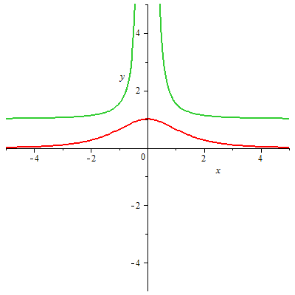

green: $f\left(x\right)=\cosh\left(\frac{1}{x}\right)$
red: $f\left(x\right)=\frac{1}{cosh⁡(x)}$

Slide 32

Theorem: The hyperbolic sine function, $f\left(x\right)=\sinh\left(x\right)$, is reciprocal even if and only if $x=±1$.
Proof:
Let $f\left(x\right)=sinh⁡(x)$.
Then $f^{′}\left(x\right)=\cosh\left(x\right)$. Note that $\cosh\left(x\right)>0$ for all real numbers $x$.
So $sinh⁡(x)$ is strictly increasing.
$\underset{⇒}{}sinh⁡(x)$ is one-to-one.
Assume $\sinh\left(x\right)=\sinh\left(\frac{1}{x}\right)$
$\underset{⇔}{}\frac{1}{x}=x$
$\underset{⇔}{}x^{2}=1$
$\underset{⇔}{}x=±1$.
Thus, the hyperbolic sin function is reciprocal even if and only if $x=±1$.
proof by Nick Kallfa and Dr. Gerald Higdon

Slide 33


red: $f\left(x\right)=sinh⁡(x)$
green: $f\left(x\right)=\sinh\left(\frac{1}{x}\right)$
blue: x=-1
violet: x=1

Slide 34

Theorem: Let $f\left(x\right)=\frac{−b\left(x+\frac{1}{x}\right)+\sqrt{b^{2}{\left(x+\frac{1}{x}\right)}^{2}−4(b^{2}−1)}}{2}∙x+b$. Then $f(x)$ is always reciprocal odd.
Proof:
Let $f\left(x\right)=\frac{−b\left(x+\frac{1}{x}\right)+\sqrt{b^{2}{\left(x+\frac{1}{x}\right)}^{2}−4(b^{2}−1)}}{2}∙x+b$.
Then $f\left(\frac{1}{x}\right)=\frac{−b\left(x+\frac{1}{x}\right)+\sqrt{b^{2}{\left(x+\frac{1}{x}\right)}^{2}−4(b^{2}−1)}}{2}∙\frac{1}{x}+b$
$=\frac{−b\left(x+\frac{1}{x}\right)+\sqrt{b^{2}{\left(x+\frac{1}{x}\right)}^{2}−4(b^{2}−1)}}{2x}+\frac{2bx}{2x}$
$=\frac{−b\left(x+\frac{1}{x}\right)+2bx+\sqrt{b^{2}{\left(x+\frac{1}{x}\right)}^{2}−4(b^{2}−1)}}{2x}∙\frac{−b\left(x+\frac{1}{x}\right)+2bx−\sqrt{b^{2}{\left(x+\frac{1}{x}\right)}^{2}−4\left(b^{2}−1\right)}}{−b\left(x+\frac{1}{x}\right)+2bx−\sqrt{b^{2}{\left(x+\frac{1}{x}\right)}^{2}−4\left(b^{2}−1\right)}}$
$=\frac{b^{2}{\left(x+\frac{1}{x}\right)}^{2}−4b^{2}x\left(x+\frac{1}{x}\right)+4b^{2}x^{2}−b^{2}{\left(x+\frac{1}{x}\right)}^{2}−4\left(b^{2}−1\right)}{2x\left(−b\left(x+\frac{1}{x}\right)+2bx−\sqrt{b^{2}{\left(x+\frac{1}{x}\right)}^{2}−4\left(b^{2}−1\right)}\right)}$
$=\frac{−4b^{2}x\left(x+\frac{1}{x}\right)+4b^{2}x^{2}−4\left(b^{2}−1\right)}{2x\left(−b\left(x+\frac{1}{x}\right)+2bx−\sqrt{b^{2}{\left(x+\frac{1}{x}\right)}^{2}−4\left(b^{2}−1\right)}\right)}$
$=\frac{−4\left(b^{2}x^{2}+b^{2}−b^{2}x^{2}−b^{2}+1\right)}{2x\left(−b\left(x+\frac{1}{x}\right)+2bx−\sqrt{b^{2}{\left(x+\frac{1}{x}\right)}^{2}−4\left(b^{2}−1\right)}\right)}$
$=−\frac{2}{x\left(−bx−\frac{b}{x}+2bx−\sqrt{b^{2}{\left(x+\frac{1}{x}\right)}^{2}−4\left(b^{2}−1\right)}\right)}$
$=−\frac{2}{x\left(bx+\frac{b}{x}−\frac{2b}{x}−\sqrt{b^{2}{\left(x+\frac{1}{x}\right)}^{2}−4\left(b^{2}−1\right)}\right)}$
$=−\frac{2}{\left(bx+\frac{b}{x}−\sqrt{b^{2}{\left(x+\frac{1}{x}\right)}^{2}−4\left(b^{2}−1\right)}\right)x−\frac{2bx}{x}}$
$=−\frac{1}{\frac{\left(b\left(x+\frac{1}{x}\right)−\sqrt{b^{2}{\left(x+\frac{1}{x}\right)}^{2}−4\left(b^{2}−1\right)}\right)∙x−2b}{2}}$
$=\frac{1}{\frac{−b\left(x+\frac{1}{x}\right)+\sqrt{b^{2}{\left(x+\frac{1}{x}\right)}^{2}−4(b^{2}−1) }}{2}∙x+b}$
$=\frac{1}{f\left(x\right)}$.
Thus, $f\left(x\right)=\frac{−b\left(x+\frac{1}{x}\right)+\sqrt{b^{2}{\left(x+\frac{1}{x}\right)}^{2}−4(b^{2}−1)}}{2}∙x+b, f(x)$ is always reciprocal odd.
proof by Jeremy Bohrer

Slide 35




graph of $f\left(\frac{1}{x}\right)=\frac{−b\left(x+\frac{1}{x}\right)+\sqrt{b^{2}{\left(x+\frac{1}{x}\right)}^{2}−4(b^{2}−1)}}{2}∙\frac{1}{x}+b$
graph of $\frac{1}{f\left(x\right)}=\frac{1}{\frac{−b\left(x+\frac{1}{x}\right)+\sqrt{b^{2}{\left(x+\frac{1}{x}\right)}^{2}−4(b^{2}−1)}}{2}∙x+b }$

